Slide 1


Slide 2
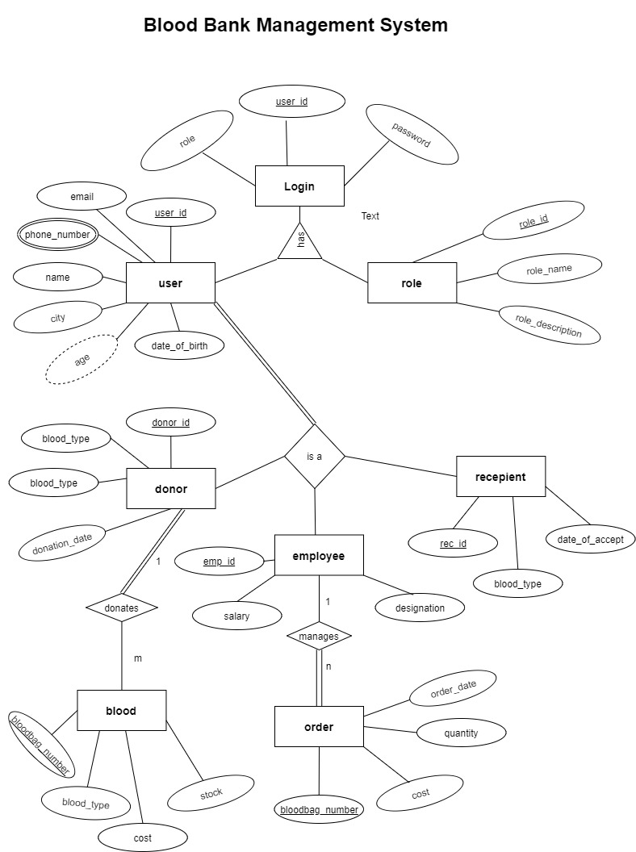
ER DIAGRAM

Slide 3
ALL CONSTRAINTS IDENTIFICATION
Mapping Cardinality
ENTITY1 | RELETIONSHIP-SET | ENTITY2 | MAPPING CARDINALITY
DONOR | DONATES | BLOOD | 1:N
RECEPTIONIST | REGISTER | DONOR | 1:N
HOSPITAL | ORDERS | BLOOD | M:N
RECIEVER | ADMITTED | HOSPITAL | M:N
BLOOD-BANK MANAGER | MANAGES | BLOOD-BANK | 1:1
RECEPTIONIST | WORKS | BLOOD-BANK | 1:1
One-to-One | 1.Any Blood bank order is managed by blood-bank-manager. 2.A receptionist works in a blood bank.
One-to-Many | 1.Every Donor has at least one recepionist. 2.Every Blood-code has at most one donor
Many-to-Many | Every hospital may order many Blood at a given cost. Every hospital had admitted at least one patient(recieiver)

Slide 4
Keys
1.Primary key
Each entity sets has its own primary keys as thiers id’s.And Reletionship sets has primary keys of its own particular entity sets.
ENTITY/RELETIONSHIP SETS | PRIMARY KEY | FOREIGN KEY
DONOR | DONOR_ID | REC_ID
BLOOD | CODE | DONOR_ID
ORDERS | BLOOD_CODE,HOSPITAL_ID | BLOOD_CODE,HOSPITAL_ID
HOSPITAL | HOSPITAL_ID | -
PHONE | PHONE_ID | HOSPITAL_ID
ADMITTED | HOSPITAL_ID,PATIENT_ID | HOSPITAL_ID,PATIENT_ID
RECIEVER(PATIENT) | PATIENT_ID | -
RECEPIONIST | REC_ID | BLOOD_BANK-ID
BLOOD-BANK | BLOOD-BANK_ID | BG_ID,EMP_ID
BLOOD-GROUP | BLOOD_GRP_ID | -
BLOOD_BANK-MANAGER | EMP_ID | -

Slide 5
ATTRIBUTES CONSTRAINTS
Composites attributes
In Blood bank manager Name is composite attributes and address in receptionist
So we have merge composites attributes to single value attributes.
RECEPTIONIST
ADDRESS (Street, City, Pincode)
RECEPTIONIST
Street
City
Pincode

Slide 6
Multivalued attributes
In Above ER diagram we have Multivalued attributes phone-number , blood group in relation of Hospital, Blood-bank
PHONE
Phone-Number_id
Phone-number
Hopital-id
Hospital
Hospital-id
{phone-number}
Hospital
Hospital-id

Slide 7
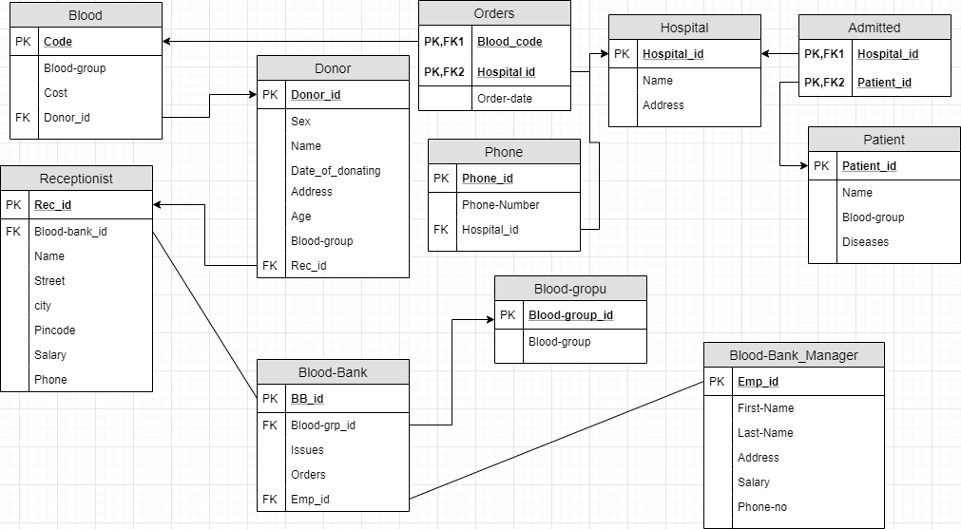
RELATIONAL MODEL DIAGRAM

